Slide 1
CLUSTERING: PART B GRADED ASSIGNMENT CREDIT SCORING
NEELAM AGARWAL
User ID: Jig11670

Slide 2
PROBLEM STATEMENT
Run a K Means clustering algorithm on the data as an unsupervised approach to see if there are Customer segments that are distinct?
How many distinct segments can you identify? Run a basic profiling for each segment created.

Slide 3
Problem Assessment
Data was imported in SAS after giving unique IDs. Manipulation and preparation of the data was done.
Data was first scaled and then each attribute was given weight based on my understanding of the data.
Fastclus was executed and Clusters were made. After approximately 20 Iterations, 12 clusters were finalized.
Following are the screenshots of some of the iterations done to derive appropriate number of clusters with reasonable number of observations

Slide 4
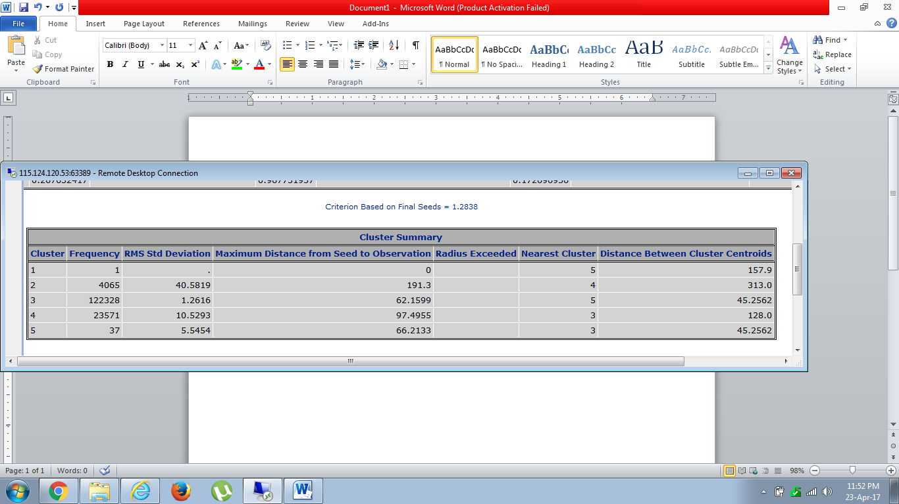
CLUSTER SUMMARY
When k=5 and monthly income, dependent and house is weighed more

Slide 5
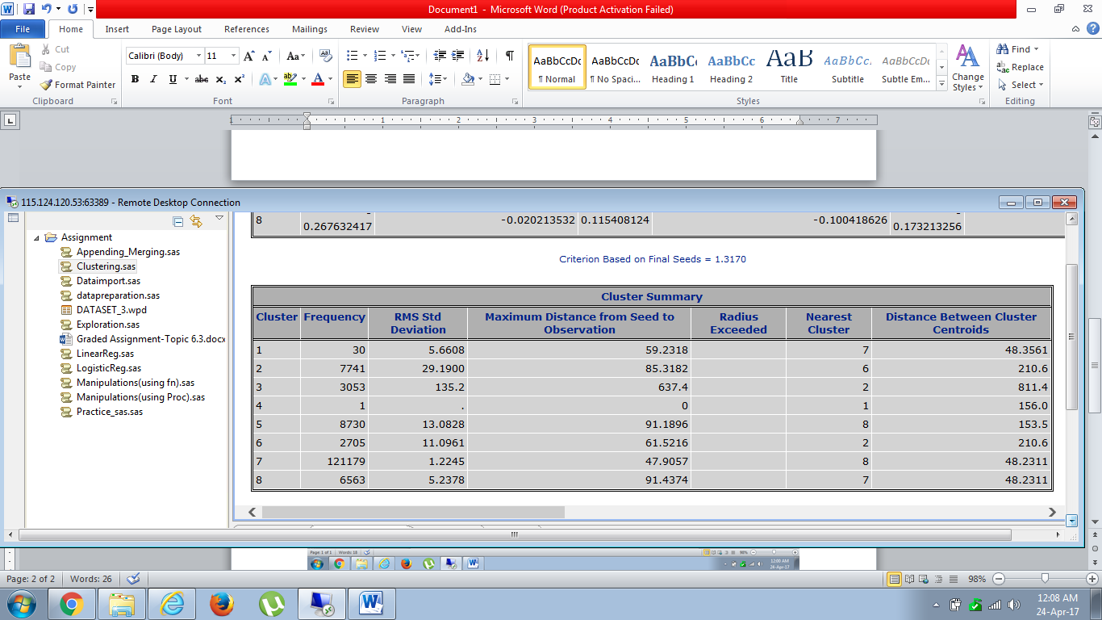
CLUSTER SUMMARY CONTD..
When k=8 and monthly income*10

Slide 6
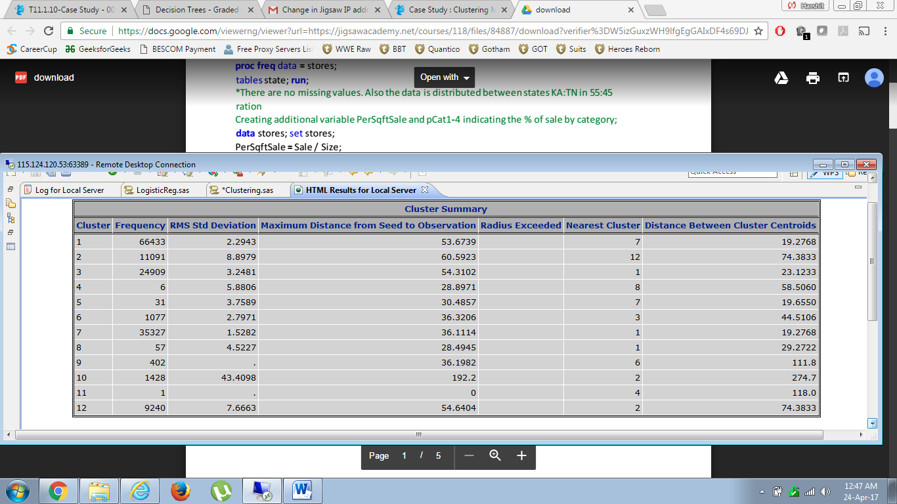
CLUSTER SUMMARY CONTD..
When k=12, income*3, dependent*10 and education*10

Slide 7
CLUSTER PROFILING
After this, the cluster data was merged with the actual data and sorted BY CLUSTERS
The Mean of individual clusters and Population was derived and Z-score was obtained from the formula,
(Pop mean-Cluster mean)/PSD
Where PSD = Population Standard Deviation
After obtaining Z-score for all the variables in each cluster, Variables from 1-12 were decided.
Following are Screen shots of all the clusters

Slide 8
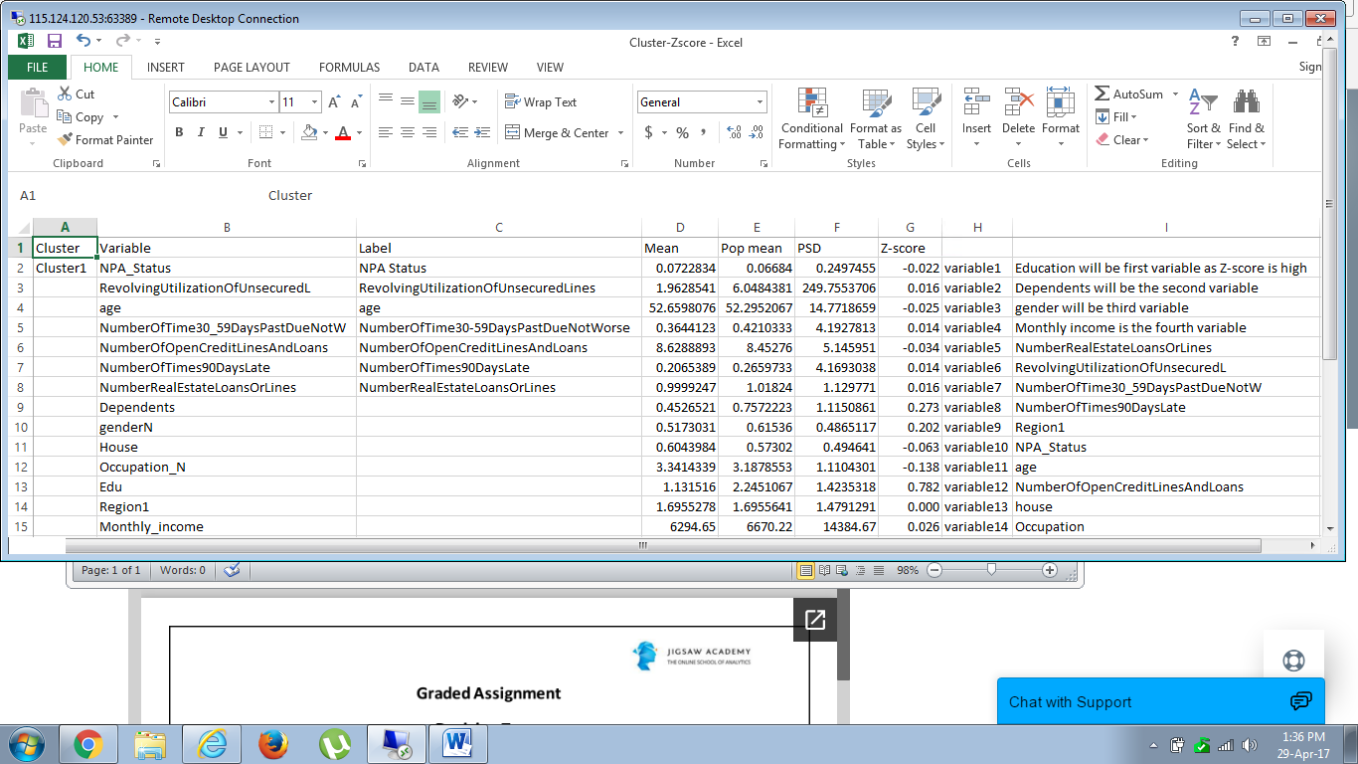
CLUSTER 1

Slide 9
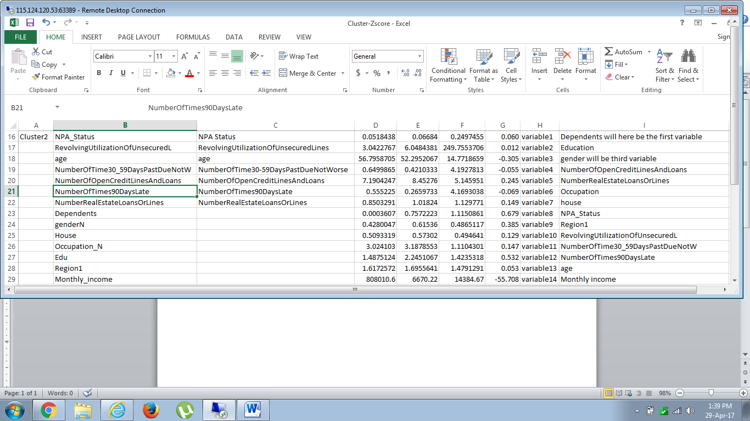
CLUSTER 2

Slide 10
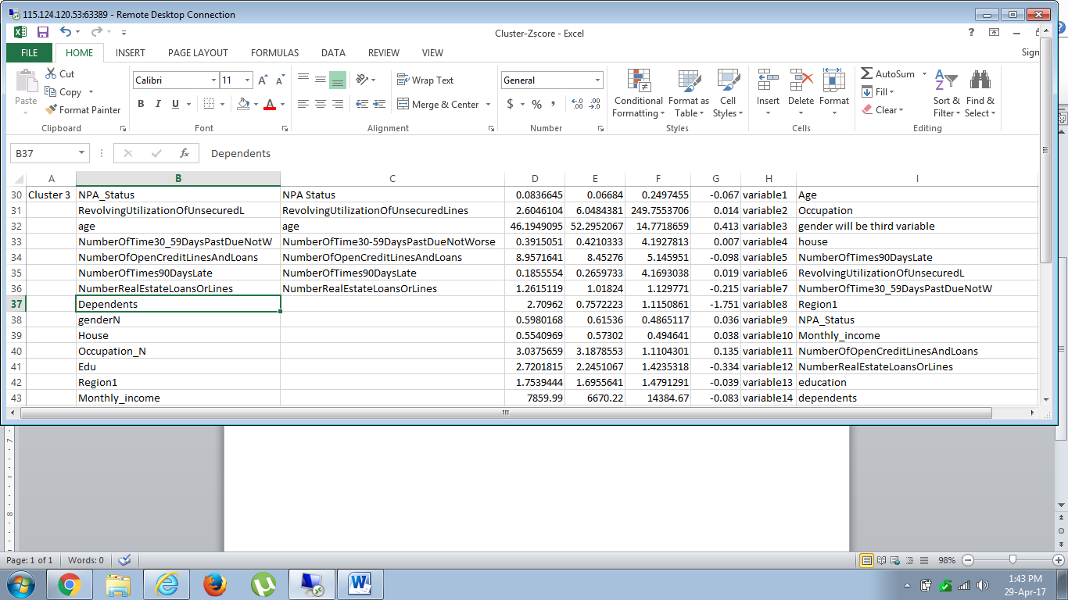
CLUSTER 3

Slide 11
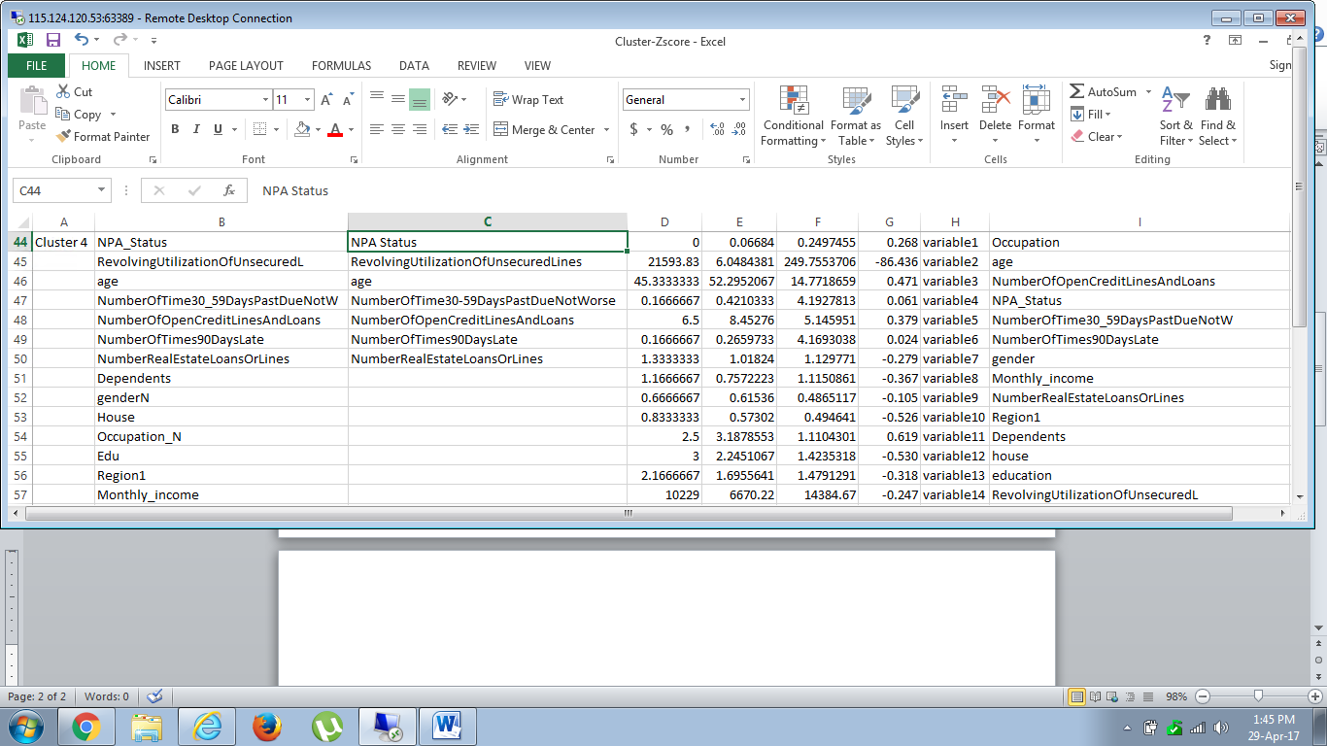
CLUSTER 4

Slide 12
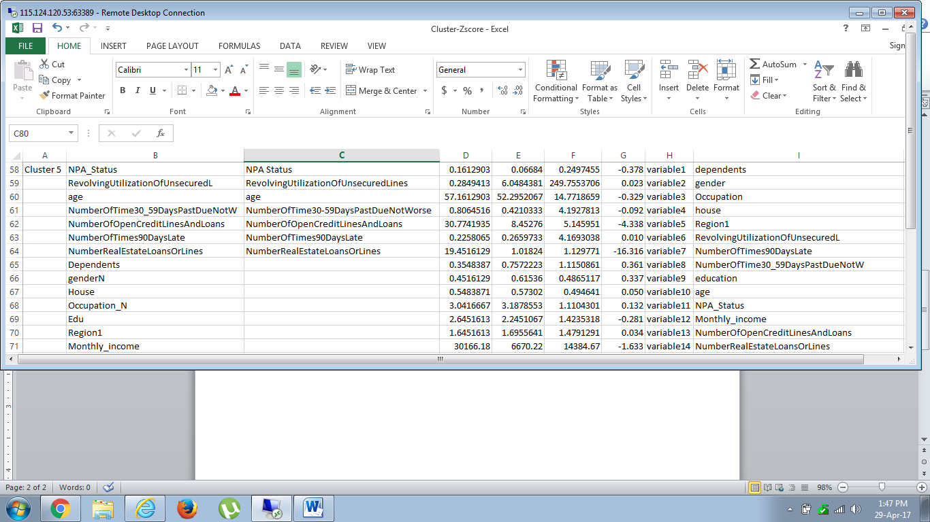
CLUSTER 5

Slide 13
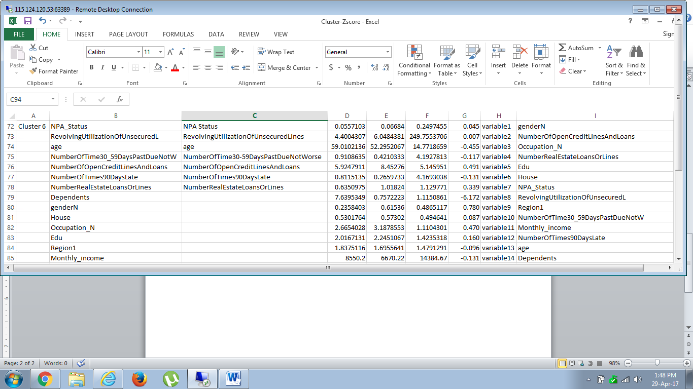
CLUSTER 6

Slide 14
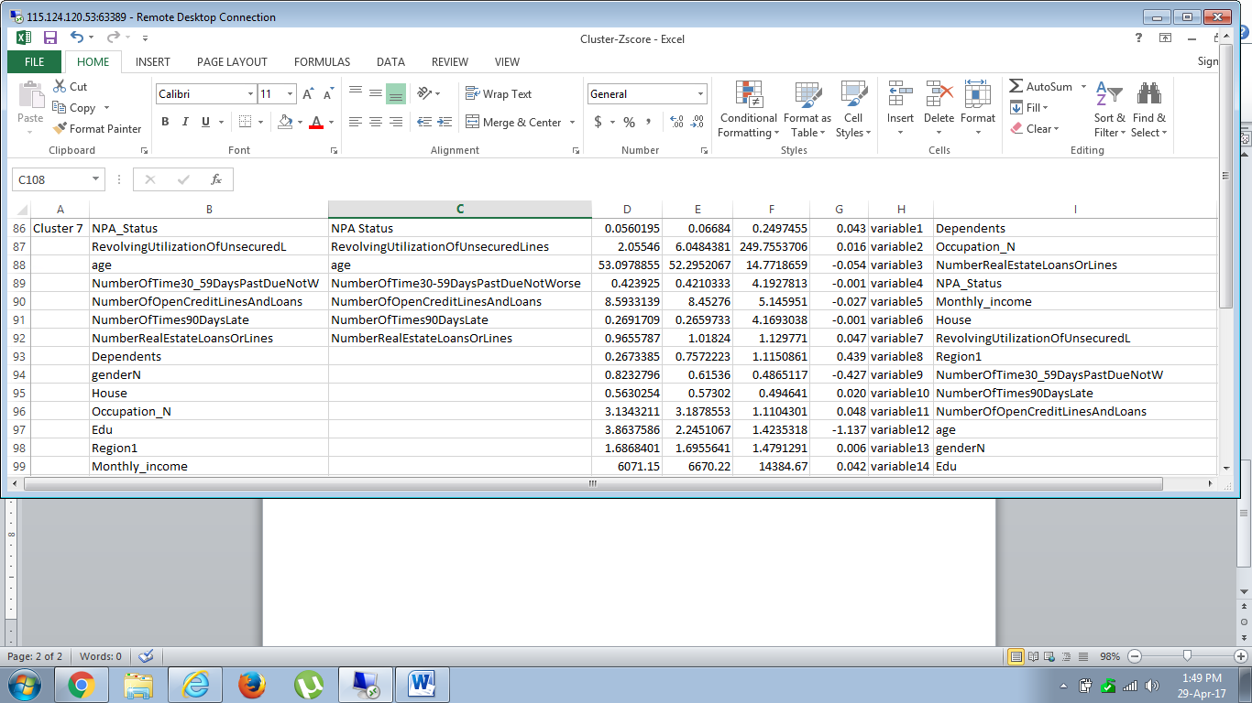
CLUSTER 7

Slide 15
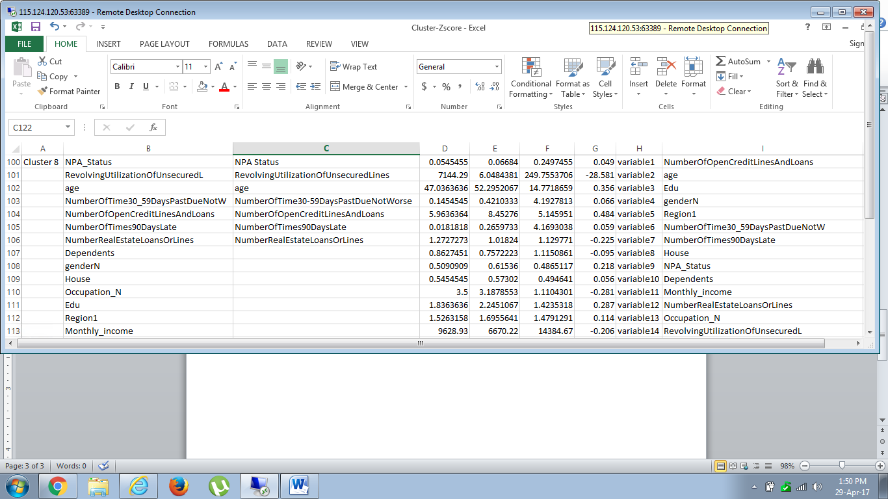
CLUSTER 8

Slide 16
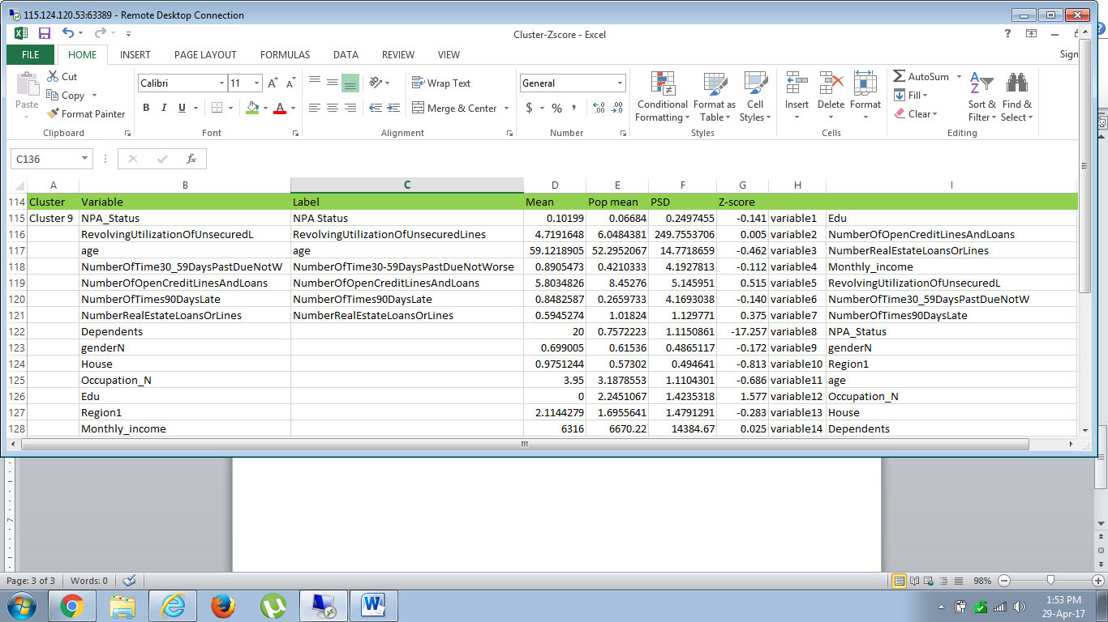
CLUSTER 9

Slide 17
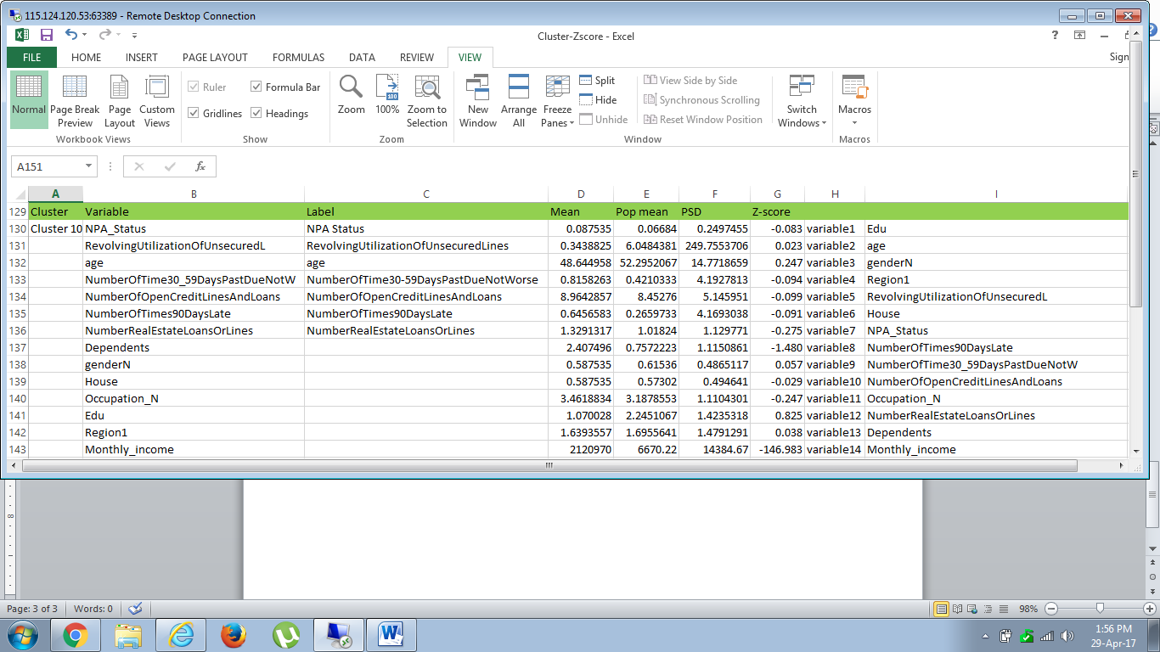
CLUSTER 10

Slide 18
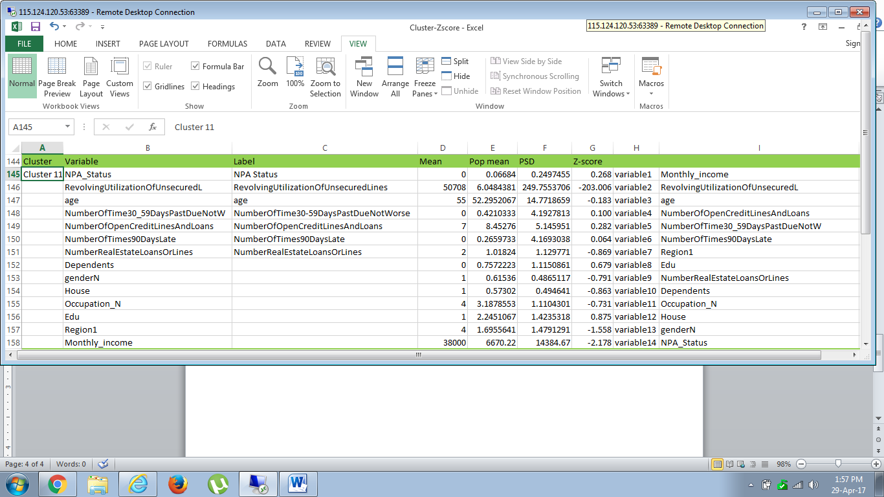
CLUSTER 11

Slide 19
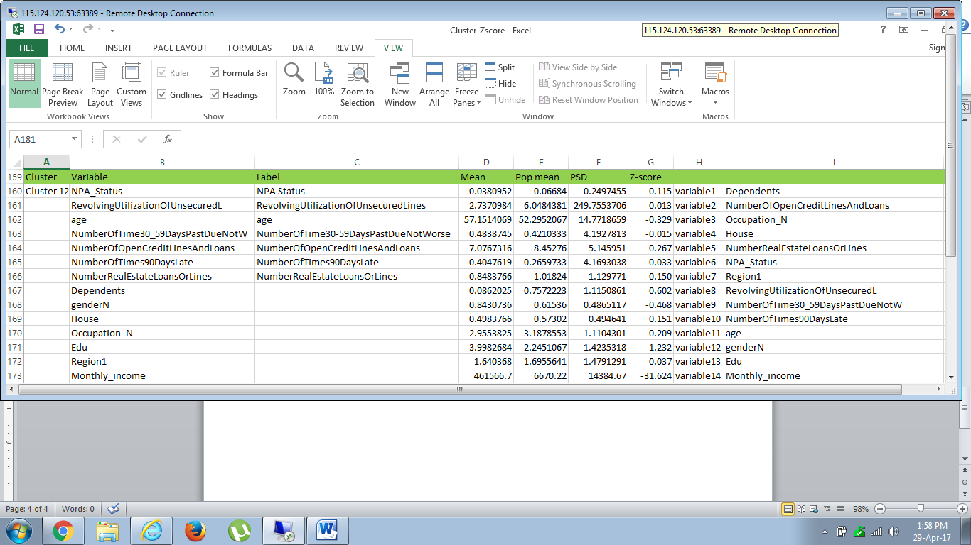
CLUSTER 12

Slide 20
CONCLUSION
K Means clustering algorithm on the data is completed.
12 distinct segments are identified.
Basic profiling for each cluster is obtained.

